Slide 1
State Space and Integrated System - Lecture 4
Instructor: Sanghyuk Lee
Sanghyuk.Lee@xjtlu.edu.cn
Tel: 8816-1415
Department of Electrical and Electronic Engineering
XJTLU

Slide 2
Contents
Feedback Control Structure
- PID/State feedback
Feedback System Characteristics
- Controllability/Observability
System Integration
- Observer with Controller

Slide 3
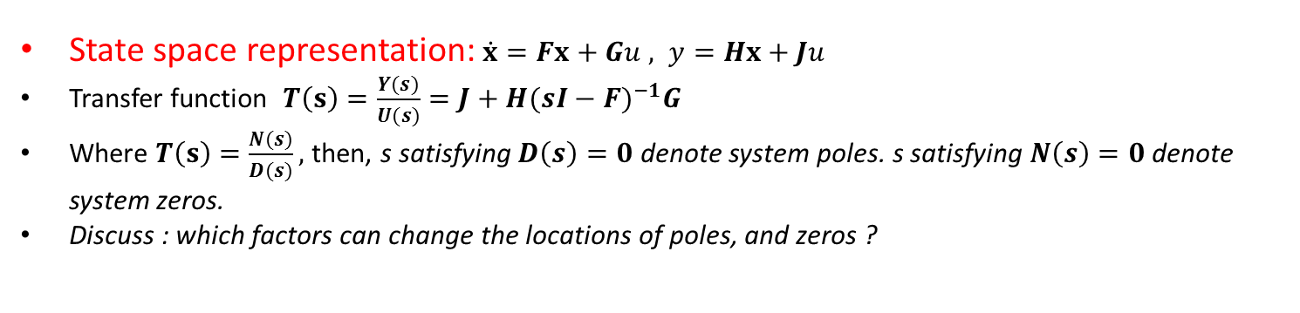
Basic Properties of Feedback
Feedback : Output Feedback/State Feedback
Output Feedback : Simple, Cheap, PID controller
State Feedback : Complex, Expensive, Modern Control Method,
connect to Observer
Feedback/Feedforward
Feedback Effect : Pole movement, how about zero ?
Feedforward : ??
State space representation: $\dot{x}=Fx+Gu , y=Hx+Ju$
Transfer function $T\left(s\right)=\frac{Y(s)}{U(s)}=J+H{(sI−F)}^{−1}G$
Where $T\left(s\right)=\frac{N(s)}{D(s)},$then, s satisfying $D\left(s\right)=0$ denote system poles. s satisfying $N\left(s\right)=0$ denote system zeros.
Discuss : which factors can change the locations of poles, and zeros ?

Slide 4
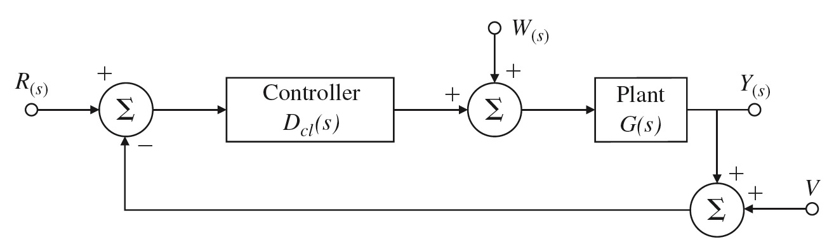
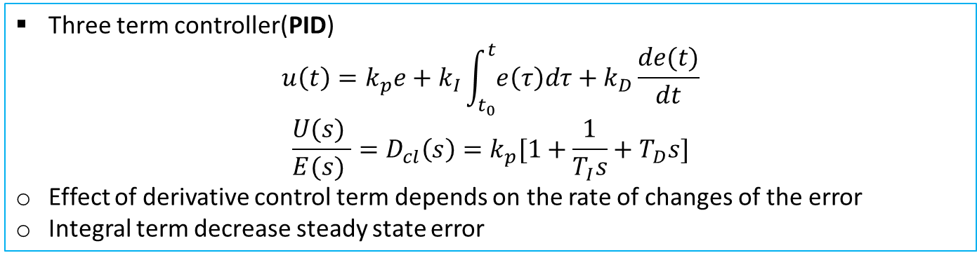
PID Controller Design
(P) and (I), additionally Derivative(D) with respect to error
Three term controller(PID)
$$u\left(t\right)=k_{p}e+k_{I}\int_{t_{0}}^{t}{e\left(τ\right)dτ}+k_{D}\frac{de(t)}{dt}$$
$$\frac{U(s) }{E(s) }=D_{cl}\left(s\right)=k_{p}[1+\frac{1}{T_{I}s}+T_{D}s]$$
Effect of derivative control term depends on the rate of changes of the error
Integral term decrease steady state error
Typical output structure : only measured output y(t) or Y(s) are used for feedback.

Slide 5
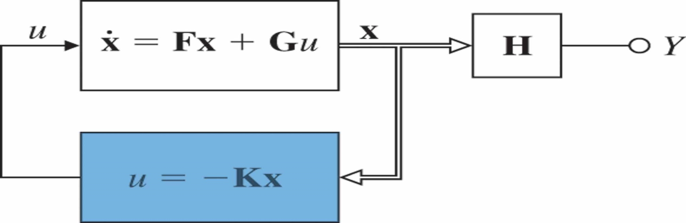
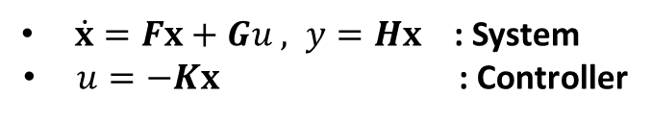
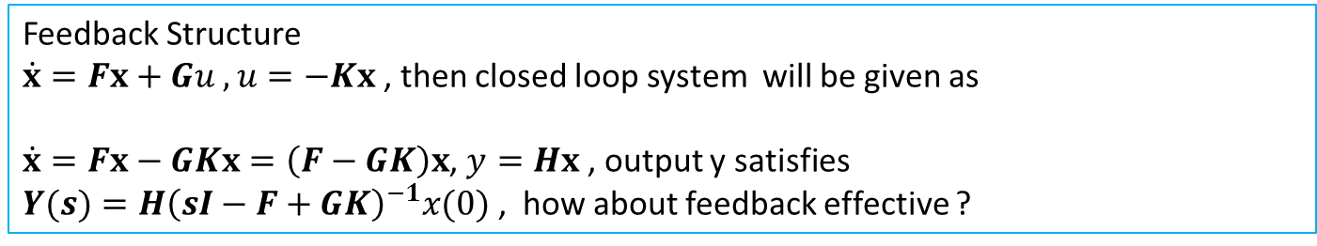
State Feedback
Consider block diagram
$\dot{x}=Fx+Gu , y=Hx$ : System
$u=−Kx$ : Controller
Feedback Structure
$\dot{x}=Fx+Gu , u=−Kx$, then closed loop system will be given as
$\dot{x}=Fx−GKx=\left(F−GK\right)x$, $y=Hx$ , output y satisfies
$Y(s)=H{\left(sI−F+GK\right)}^{−1}x(0)$ , how about feedback effective ?

Slide 6
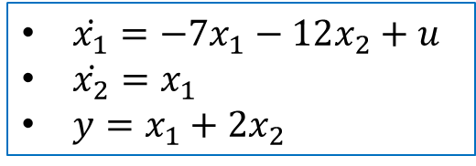
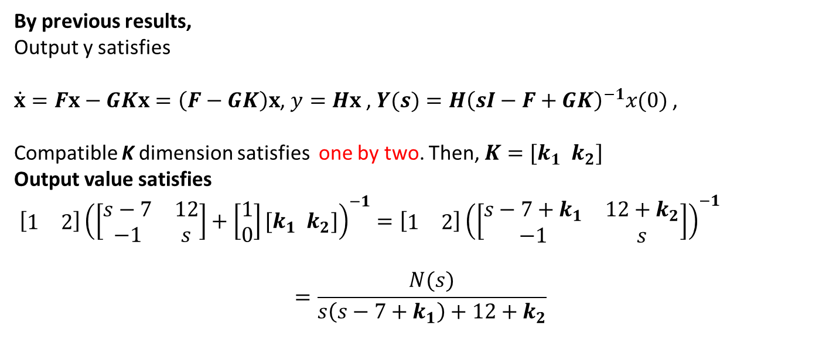
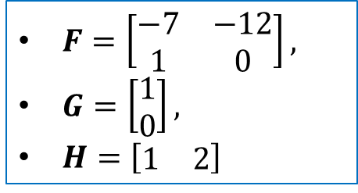
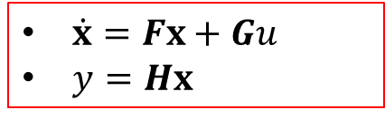
Example
$\dot{x_{1}}=−7x_{1}−12x_{2}+u$
$\dot{x_{2}}=x_{1}$
$y=x_{1}+2x_{2}$
$\dot{x}=Fx+Gu$
$y=Hx$
$F=\left[\begin{matrix}−7 & −12 \\ 1 & 0\end{matrix}\right],$
$G=\left[\begin{matrix}1 \\ 0\end{matrix}\right],$
$H=\left[\begin{matrix}1 & 2\end{matrix}\right]$
With $u=−Kx$, construct state feedback controller
By previous results,
Output y satisfies
$\dot{x}=Fx−GKx=\left(F−GK\right)x$, $y=Hx$ , $Y(s)=H{\left(sI−F+GK\right)}^{−1}x(0)$ ,
Compatible K dimension satisfies one by two. Then, $K=[k_{1} k_{2}]$
Output value satisfies
$\left[\begin{matrix}1 & 2\end{matrix}\right]{\left(\left[\begin{matrix}s−7 & 12 \\ −1 & s\end{matrix}\right]+\left[\begin{matrix}1 \\ 0\end{matrix}\right][k_{1} k_{2}]\right)}^{−1}=\left[\begin{matrix}1 & 2\end{matrix}\right]{\left(\left[\begin{matrix}s−7+k_{1} & 12+k_{2} \\ −1 & s\end{matrix}\right]\right)}^{−1}$
$$=\frac{N(s)}{s\left(s−7+k_{1}\right)+12+k_{2}}$$

Slide 7
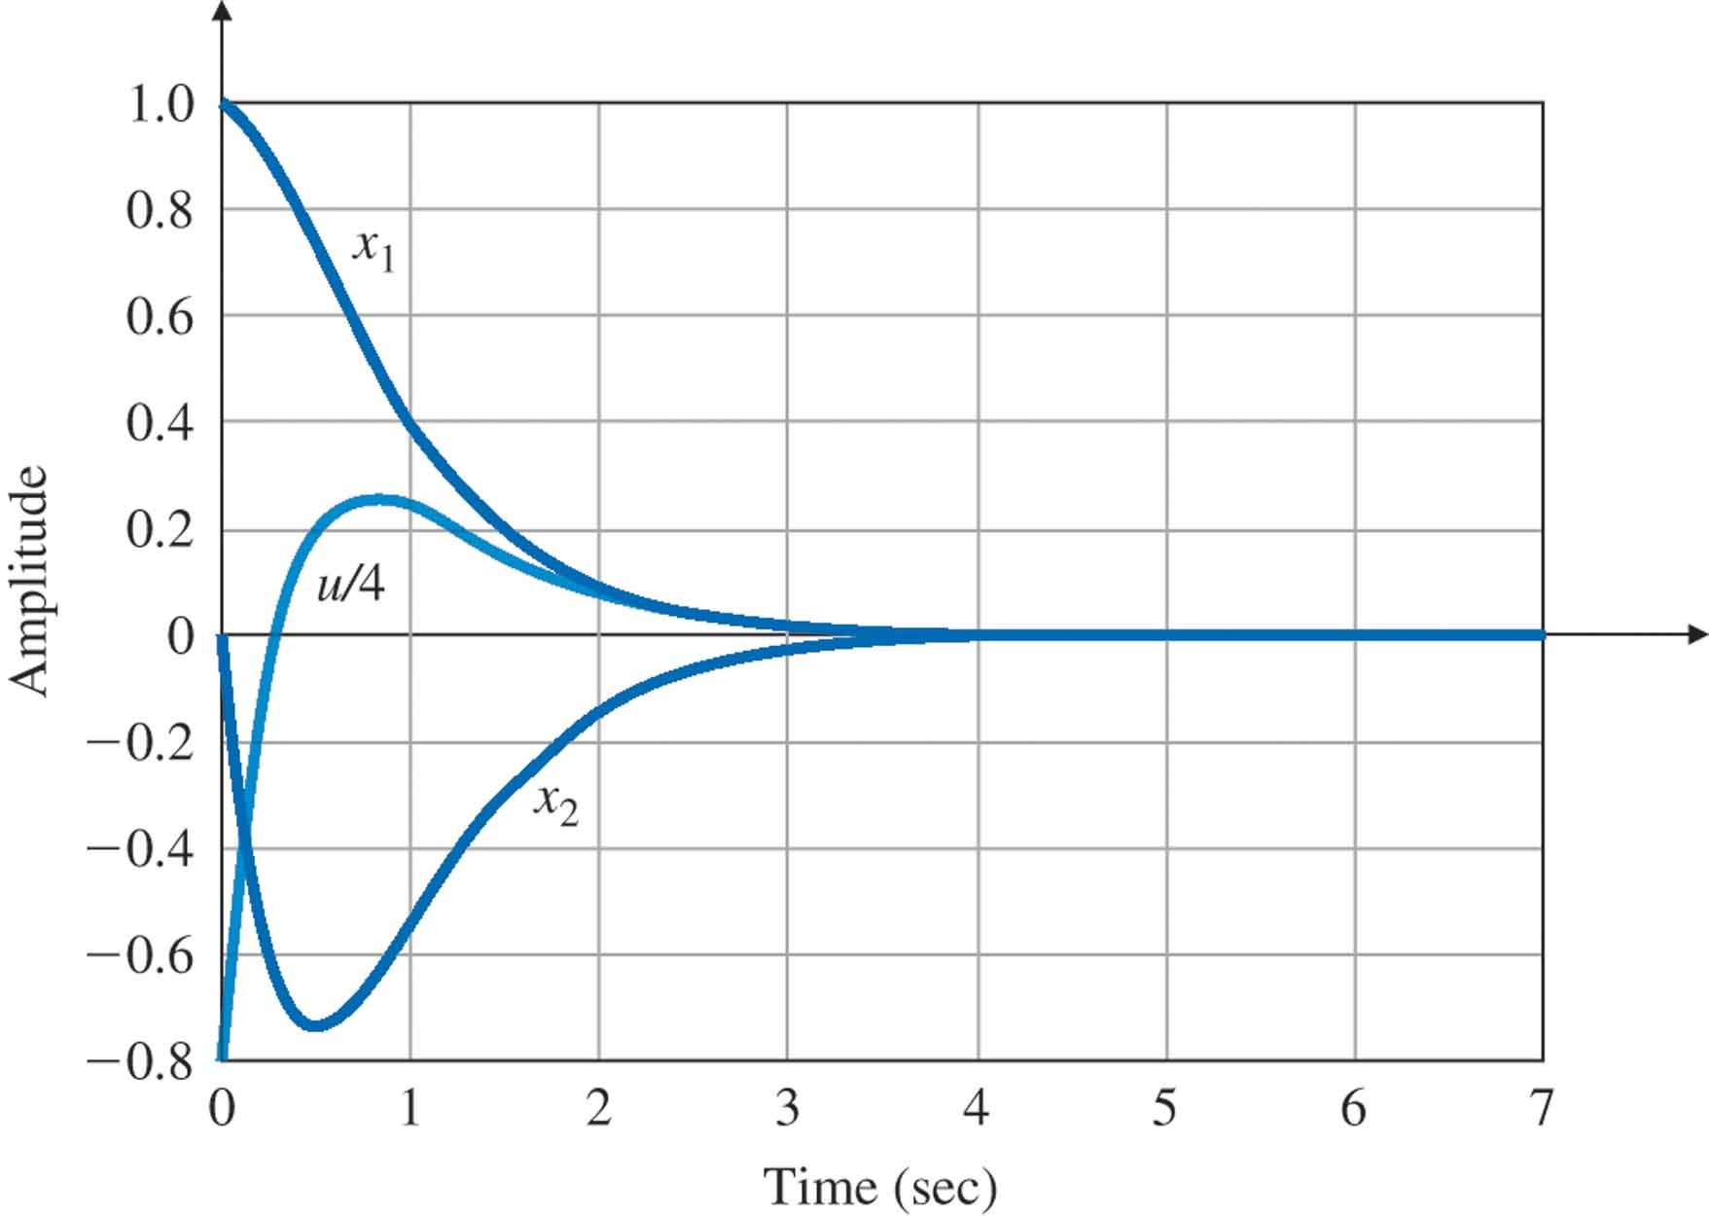
Effectiveness of state feedback
Performance Improvement
Hindrance ?
Impulse response of the undamped oscillator with full-state feedback

Slide 8
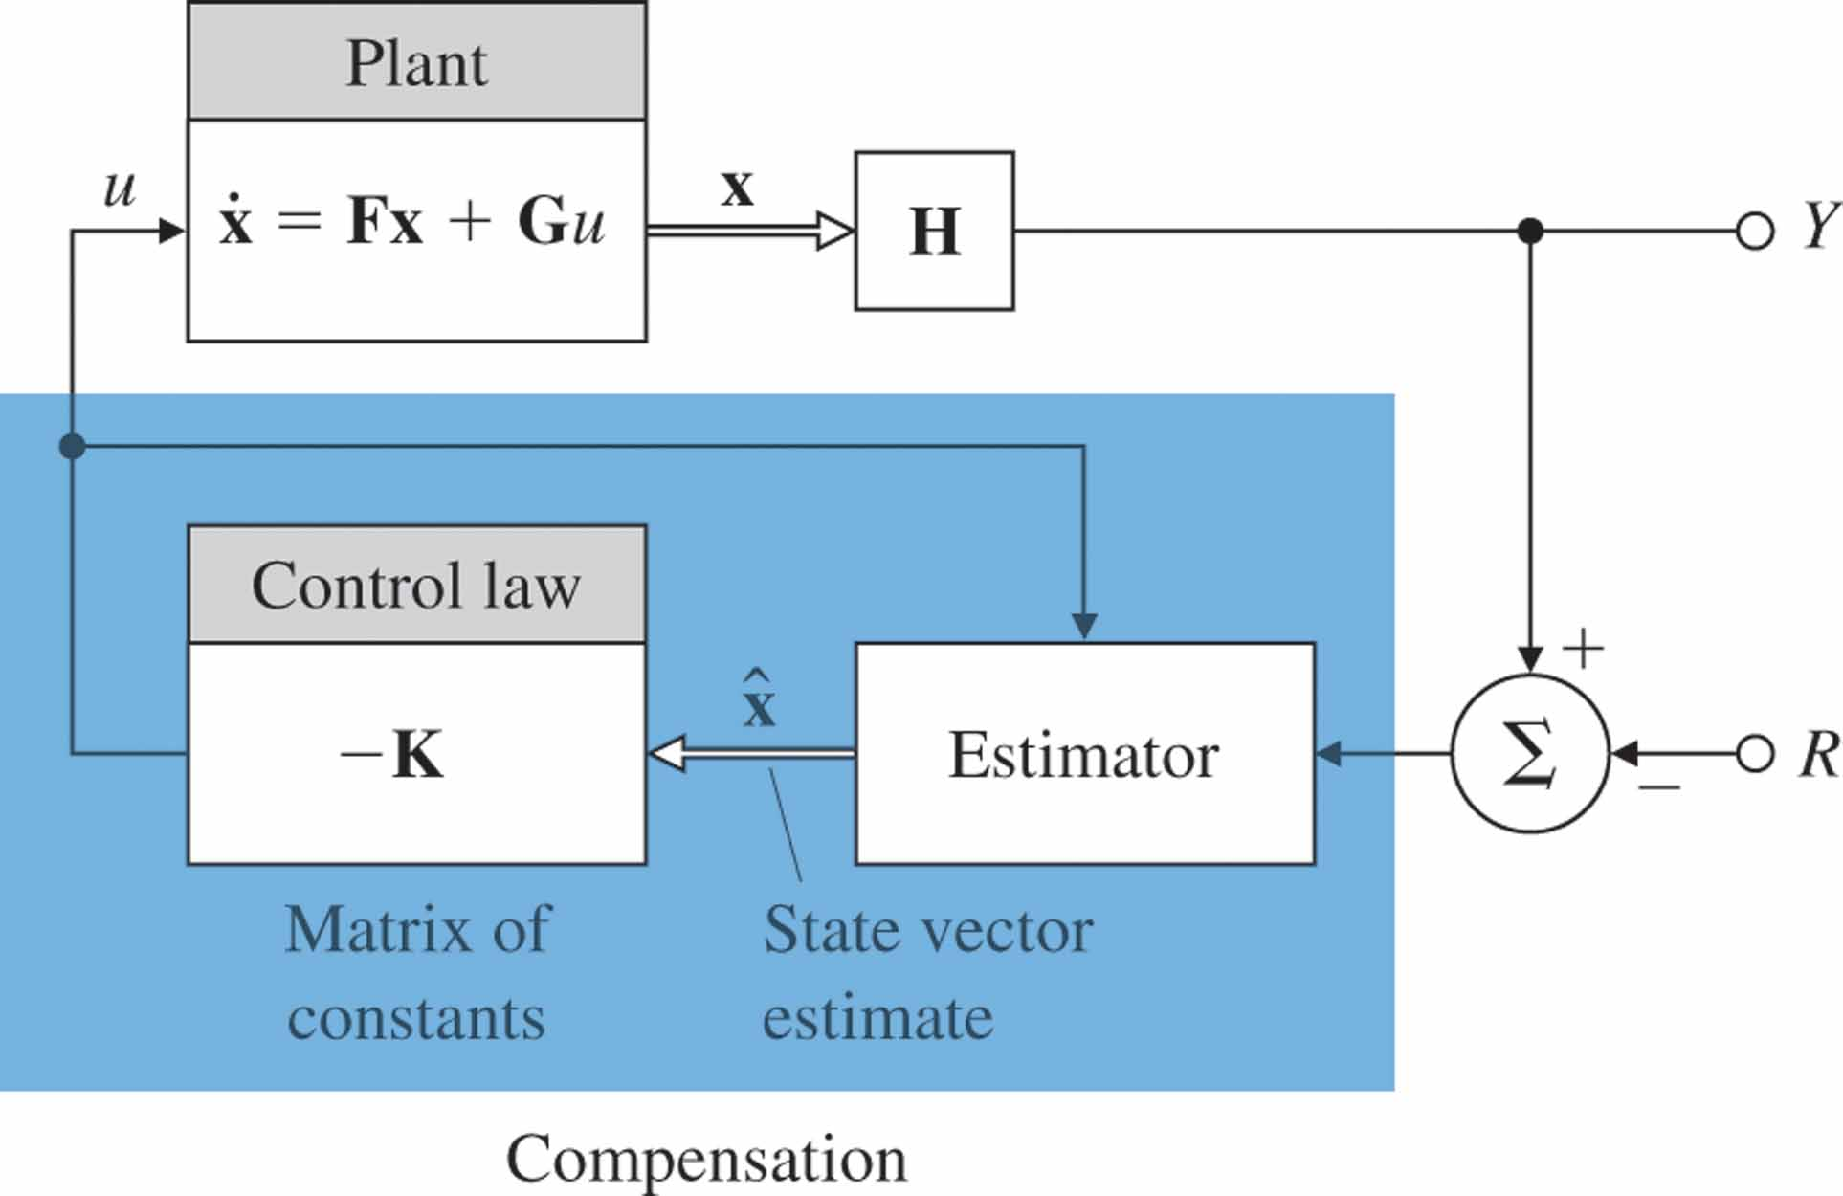
Effectiveness of state feedback
When the state variables x are not available, how to construct $u=−Kx$ ??

Slide 9
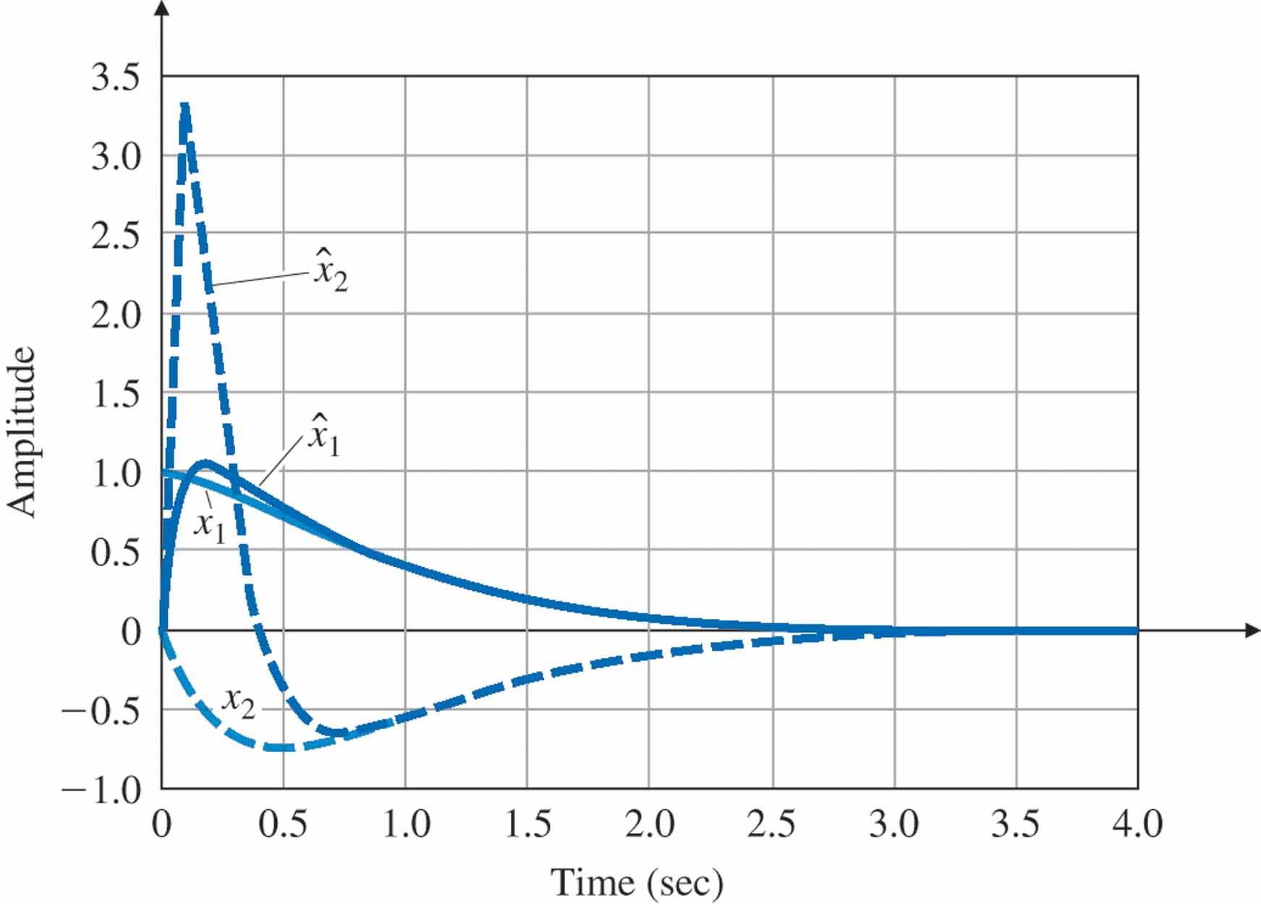
Estimator/Observer
Design auxiliary system for real plant, and make $\hat{x}→x$

Slide 10
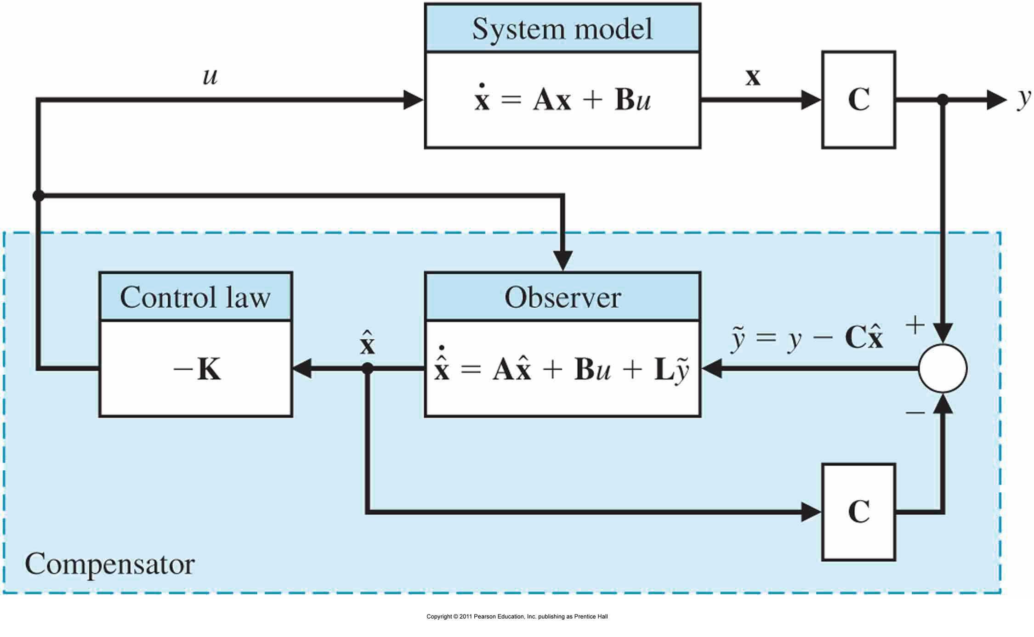
Full State Feedback Controller Design
Full state feedback is not possible(in general), observer needs to make $\hat{x}→x$

Slide 11
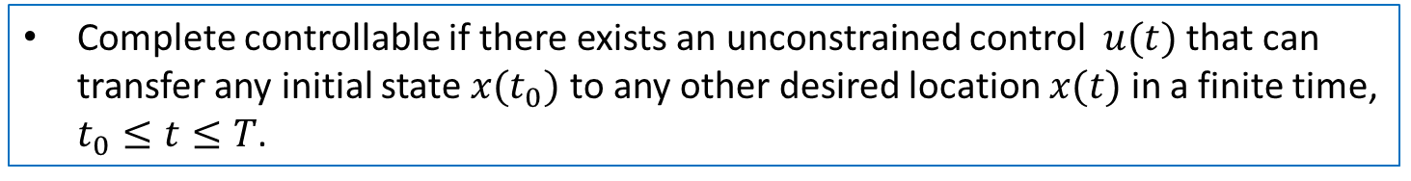
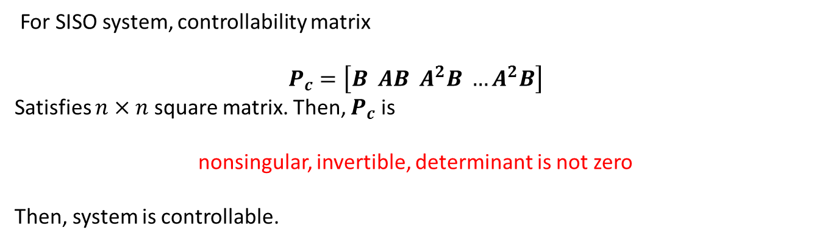
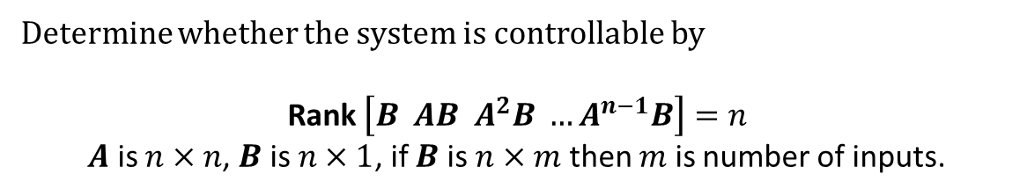
Controllability
Complete controllable if there exists an unconstrained control $u(t)$ that can transfer any initial state ${x(t}_{0})$ to any other desired location $x(t)$ in a finite time, $t_{0}≤t≤T$.
For the system
$$\dot{x}=Ax+Bu$$
Determine whether the system is controllable by
Rank $\left[B AB A^{2}B …A^{n−1}B\right]=n$
$A$ is $n×n$, $B$ is $n×1$, if $B$ is $n×m$ then $m$ is number of inputs.
For SISO system, controllability matrix
$$P_{c}=\left[B AB A^{2}B …A^{2}B\right]$$
Satisfies $n×n$ square matrix. Then, $P_{c}$ is
nonsingular, invertible, determinant is not zero
Then, system is controllable.

Slide 12
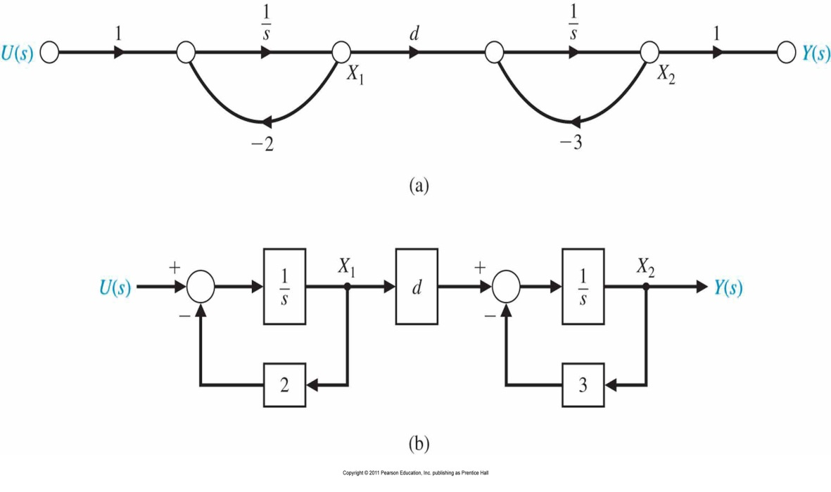
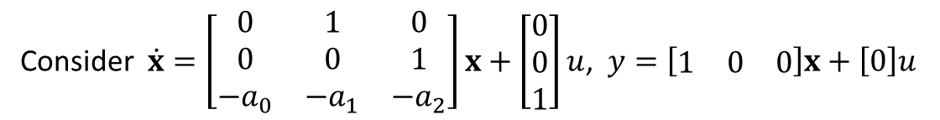
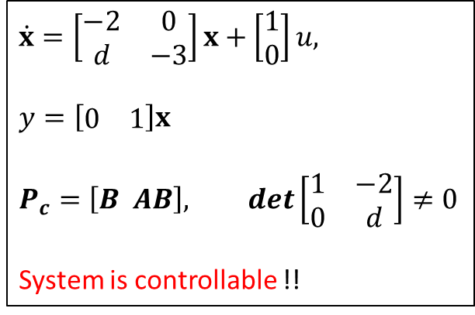
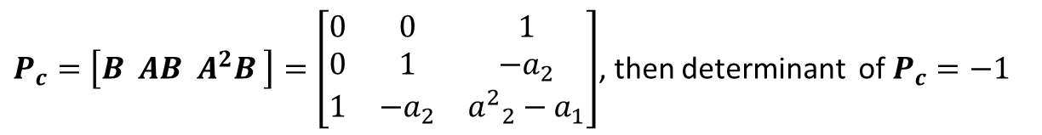
Controllability
Example
Consider $\dot{x}=\left[\begin{matrix}0 & 1 & 0 \\ 0 & 0 & 1 \\ −a_{0} & −a_{1} & −a_{2}\end{matrix}\right]x+\left[\begin{matrix}0 \\ 0 \\ 1\end{matrix}\right]u$, $y=\left[\begin{matrix}1 & 0 & 0\end{matrix}\right]x+\left[0\right]u$
$P_{c}=\left[B AB A^{2}B \right]=\left[\begin{matrix}0 & 0 & 1 \\ 0 & 1 & −a_{2} \\ 1 & −a_{2} & {a^{2}}_{2}^{}−a_{1}\end{matrix}\right]$, then determinant of $P_{c}=−1$
$$\dot{x}=\left[\begin{matrix}−2 & 0 \\ d & −3\end{matrix}\right]x+\left[\begin{matrix}1 \\ 0\end{matrix}\right]u,$$
$$y=\left[\begin{matrix}0 & 1\end{matrix}\right]x$$
$$P_{c}=\left[B AB\right], det\left[\begin{matrix}1 & −2 \\ 0 & d\end{matrix}\right]≠0$$
System is controllable !!

Slide 13
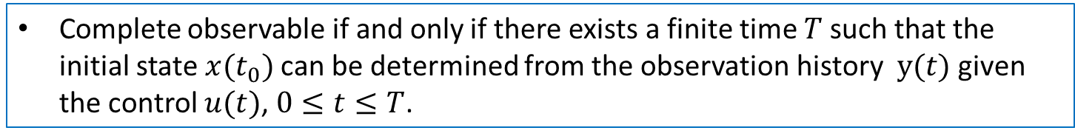
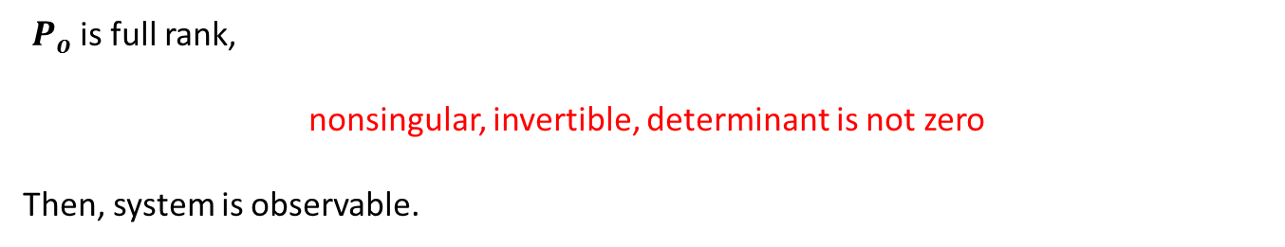
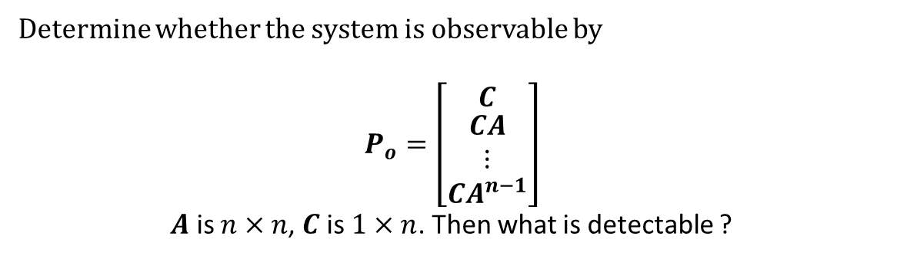

Observability
Complete observable if and only if there exists a finite time $T$such that the initial state ${x(t}_{0})$can be determined from the observation history $y(t)$ given the control $u(t)$, $0≤t≤T$.
For the system
$\dot{x}=Ax+Bu$, $y=Cx$
Determine whether the system is observable by
$$P_{o}=\left[\begin{matrix}C \\ \begin{matrix}CA \\ ⋮\end{matrix} \\ CA^{n−1}\end{matrix}\right]$$
$A$ is $n×n$, $C$ is $1×n$. Then what is detectable ?
$P_{o}$ is full rank,
nonsingular, invertible, determinant is not zero
Then, system is observable.

Slide 14
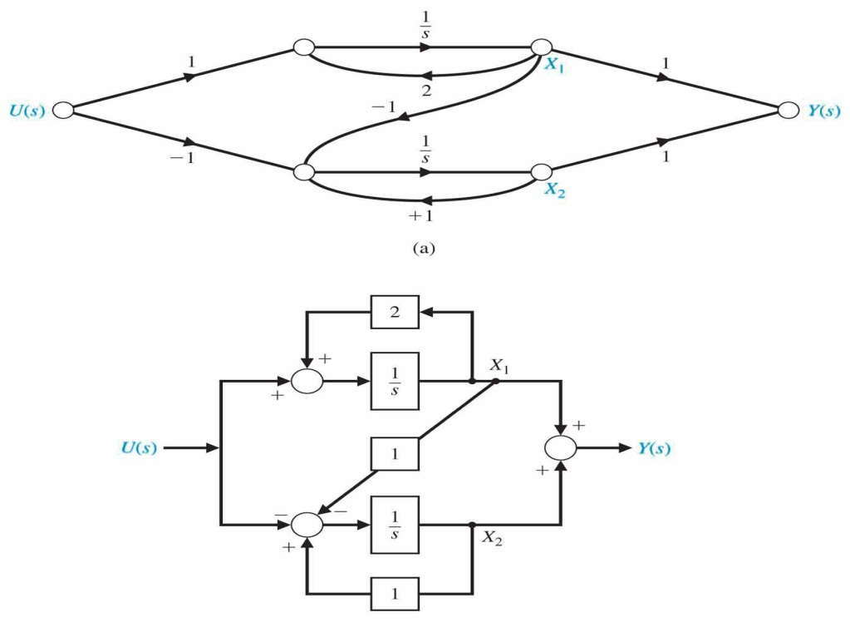
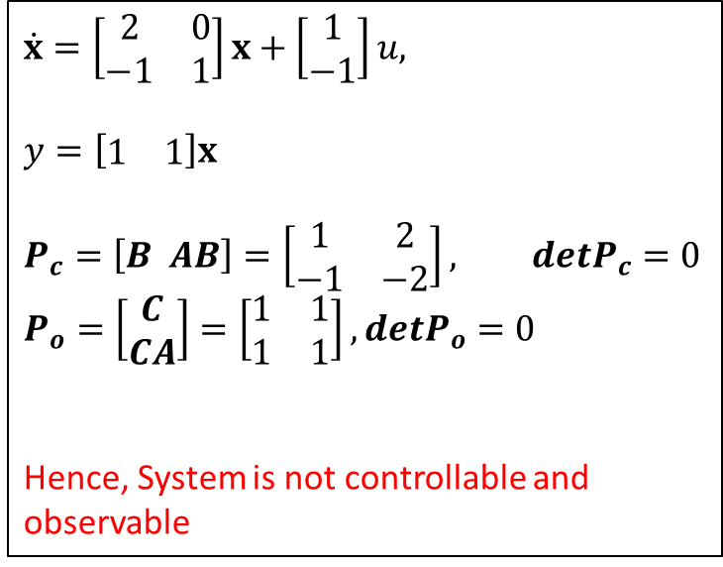
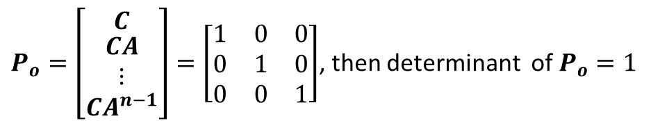
Observability
Example
Consider $\dot{x}=\left[\begin{matrix}0 & 1 & 0 \\ 0 & 0 & 1 \\ −a_{0} & −a_{1} & −a_{2}\end{matrix}\right]x+\left[\begin{matrix}0 \\ 0 \\ 1\end{matrix}\right]u$, $y=\left[\begin{matrix}1 & 0 & 0\end{matrix}\right]x+\left[0\right]u$
$P_{o}=\left[\begin{matrix}C \\ \begin{matrix}CA \\ ⋮\end{matrix} \\ CA^{n−1}\end{matrix}\right]=\left[\begin{matrix}1 & 0 & 0 \\ 0 & 1 & 0 \\ 0 & 0 & 1\end{matrix}\right]$, then determinant of $P_{o}=1$
$$\dot{x}=\left[\begin{matrix}2 & 0 \\ −1 & 1\end{matrix}\right]x+\left[\begin{matrix}1 \\ −1\end{matrix}\right]u,$$
$$y=\left[\begin{matrix}1 & 1\end{matrix}\right]x$$
$$P_{c}=\left[B AB\right]=\left[\begin{matrix}1 & 2 \\ −1 & −2\end{matrix}\right], detP_{c}=0$$
$$P_{o}=\left[\begin{matrix}C \\ CA\end{matrix}\right]=\left[\begin{matrix}1 & 1 \\ 1 & 1\end{matrix}\right],detP_{o}=0$$
Hence, System is not controllable and observable

Slide 15
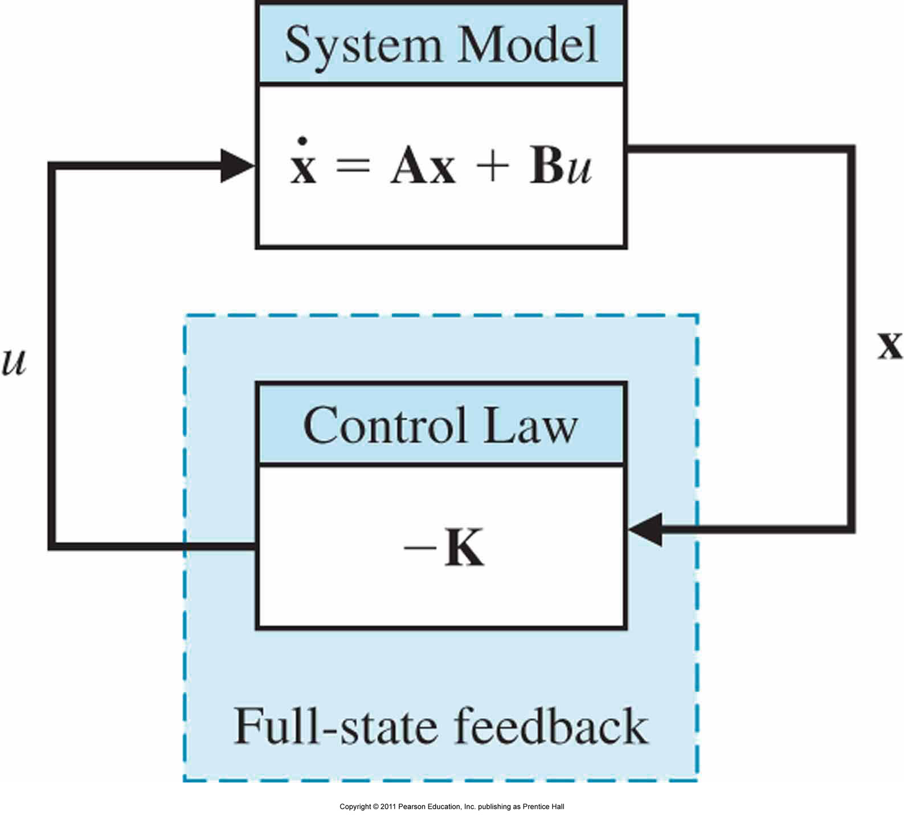
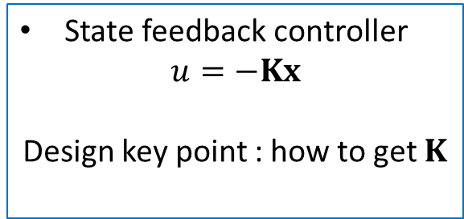
State Feedback Controller Design
State feedback controller
$u=−Kx$
Design key point : how to get $K$
Separation principle
Full state feedback + Observer Design
Two design occur independent, this provides the proof.
Closed loop system
$$\dot{x}=Ax+Bu$$
$=Ax−BKx=\left(A−BK\right)x$
Then $det(λI−\left(A−BK\right))=0$
Satisfy closed loop eigenvalues

Slide 16
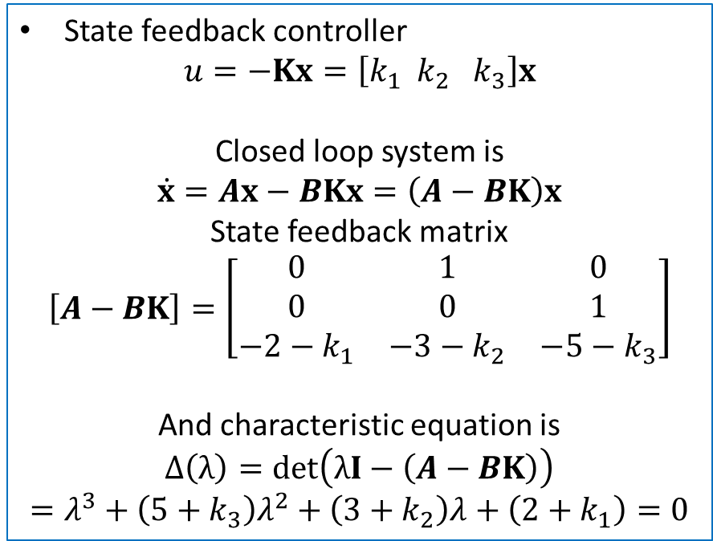
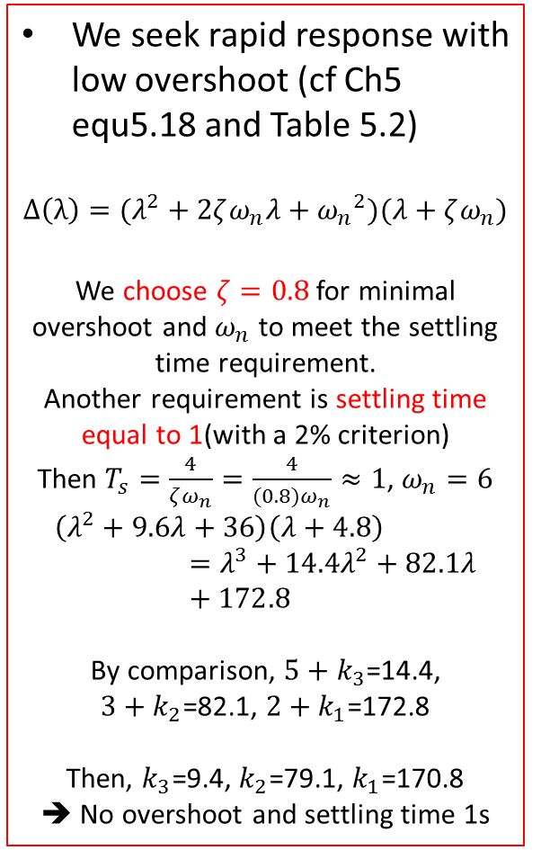
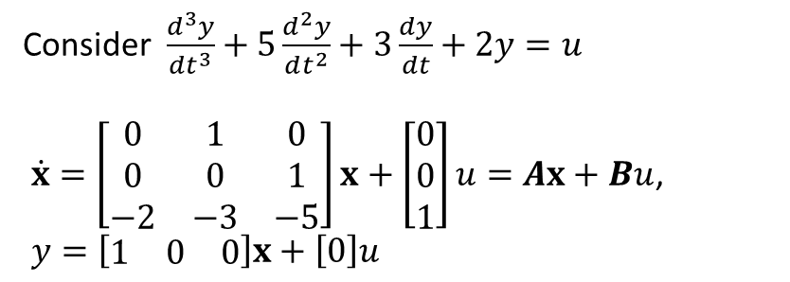
Example
Consider $\frac{d^{3}y}{dt^{3}}+5\frac{d^{2}y}{dt^{2}}+3\frac{dy}{dt}+2y=u$
$\dot{x}=\left[\begin{matrix}0 & 1 & 0 \\ 0 & 0 & 1 \\ −2 & −3 & −5\end{matrix}\right]x+\left[\begin{matrix}0 \\ 0 \\ 1\end{matrix}\right]u=Ax+Bu$,
$y=\left[\begin{matrix}1 & 0 & 0\end{matrix}\right]x+\left[0\right]u$
We seek rapid response with low overshoot (cf Ch5 equ5.18 and Table 5.2)
$$Δ\left(λ\right)=(λ^{2}+2ζω_{n}λ+{ω_{n}}^{2})(λ+ζω_{n})$$
We choose $ζ=0.8$ for minimal overshoot and $ω_{n}$ to meet the settling time requirement.
Another requirement is settling time equal to 1(with a 2% criterion)
Then $T_{s}=\frac{4}{ζω_{n}}=\frac{4}{(0.8)ω_{n}}≈1$, $ω_{n}=6$
$$\left(λ^{2}+9.6λ+36\right)\left(λ+4.8\right)=λ^{3}+14.4λ^{2}+82.1λ+172.8$$
By comparison, $5+k_{3}$=14.4,
$3+k_{2}$=82.1, $2+k_{1}$=172.8
Then, $k_{3}$=9.4, $k_{2}$=79.1, $k_{1}$=170.8
➔ No overshoot and settling time 1s
State feedback controller
$$u=−Kx=\left[k_{1} k_{2} k_{3}\right]x$$
Closed loop system is
$\dot{x}=Ax−BKx=\left(A−BK\right)x$
State feedback matrix
$$\left[A−BK\right]=\left[\begin{matrix}0 & 1 & 0 \\ 0 & 0 & 1 \\ −2−k_{1} & −3−k_{2} & −5−k_{3}\end{matrix}\right]$$
And characteristic equation is
$$Δ\left(λ\right)=det\left(λI−\left(A−BK\right)\right)$$
$=λ^{3}+\left(5+k_{3}\right)λ^{2}+\left(3+k_{2}\right)λ+\left(2+k_{1}\right)=0$

Slide 17
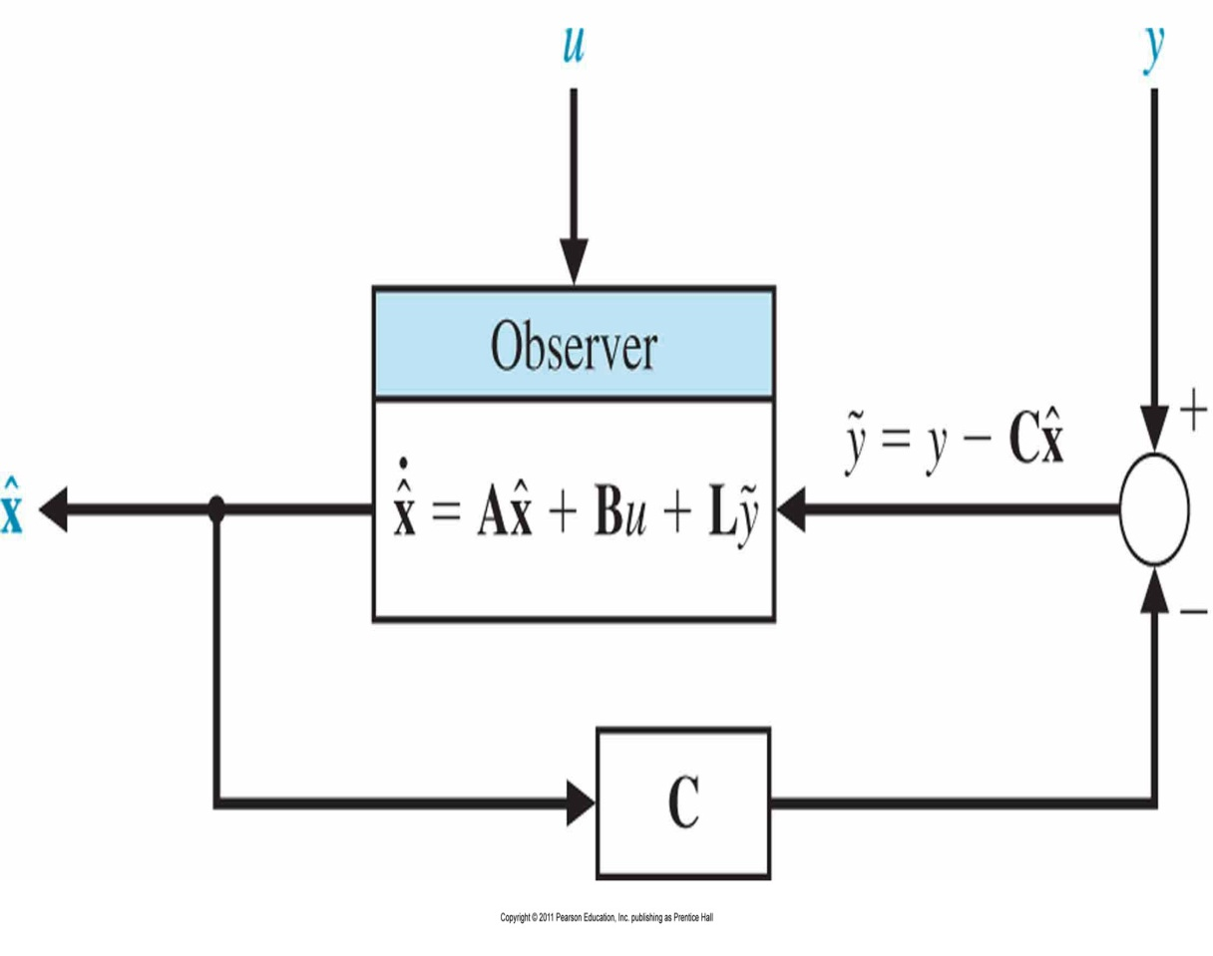
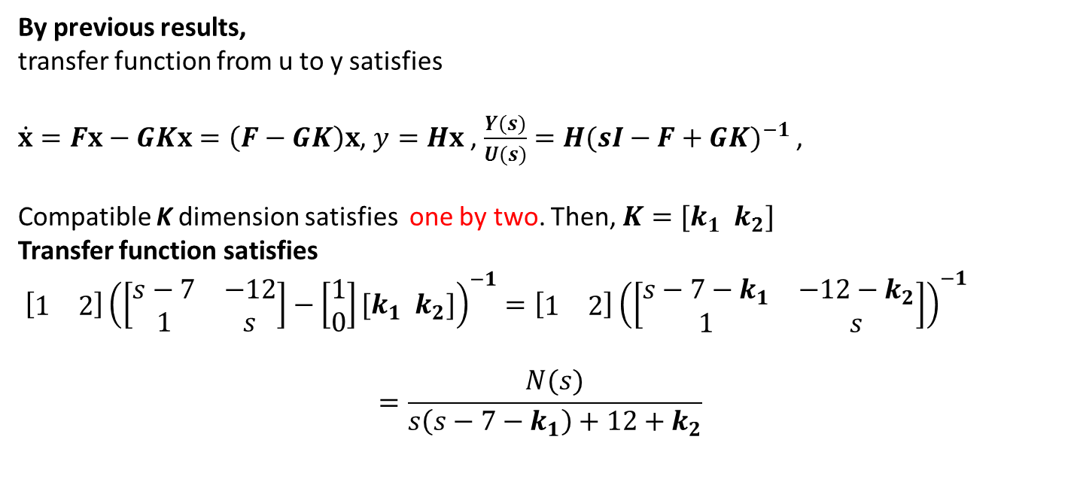
Observer Design
Why do we design observer ?
Goal of observer is to provide $\hat{x}$ so that $\hat{x}→x$ as $t→∞$.
Observer structure(Luenberger)
$$\dot{\hat{x}}=A\hat{x}+Bu+L(y−C\hat{x})$$
Let $e\left(t\right)=x\left(t\right)−\hat{x}(t)$
Taking the time derivative of the estimation error
$$\dot{e}=\dot{x}−\dot{\hat{x}}$$
Then, $\dot{e}=Ax+Bu−A\hat{x}−Bu−L(y−C\hat{x})$ or $\dot{e}(t)=\left(A−LC\right)e(t)$
We guarantee $e\left(t\right)→0$ as $t→∞$ for any initial tracking error $e\left(t_{0}\right)$ if the characteristic equation
$$det\left(λI−\left(A−LC\right)\right)=0$$
All root are in Left Half Plane $↔$ Complete Observable $↔$ Observability matrix $P_{o}$ has full rank

Slide 18
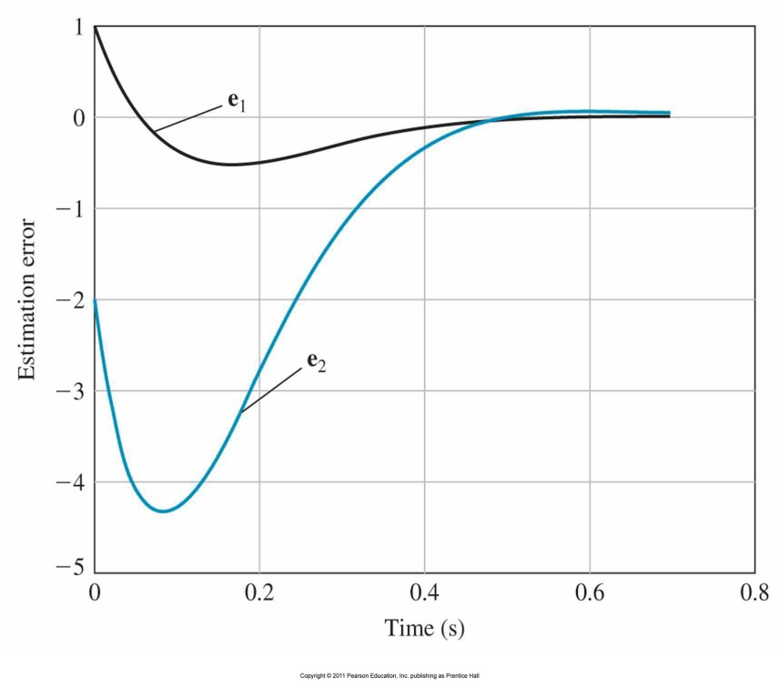
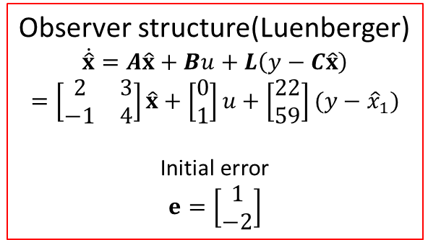
Example
Consider
$\dot{x}=\left[\begin{matrix}2 & 3 \\ −1 & 4\end{matrix}\right]x+\left[\begin{matrix}0 \\ 1\end{matrix}\right]u=Ax+Bu$, $y=\left[\begin{matrix}1 & 0\end{matrix}\right]x+\left[0\right]u$
Observability matrix is
$P_{o}=\left[\begin{matrix}C \\ CA\end{matrix}\right]=\left[\begin{matrix}1 & 0 \\ 2 & 3\end{matrix}\right]$.
Since ${det P}_{o}=3≠0$, system is complete observable.
And characteristic equation is
$$Δ_{d}\left(λ\right)=det\left(λI−\left(A−LC\right)\right)$$
$$=λ^{2}+\left(L_{1}−6\right)λ−4\left(L_{1}−2)+3(L_{2}+1\right)$$
Where $L={\left[\begin{matrix}L_{1} & L_{2}\end{matrix}\right]}^{T}$
We select $ζ=0.8$ and $ω_{n}=10$, resulting in an expected settling time of less than 0.5 sec.
Then, $Δ_{d}\left(λ\right)=λ^{2}+2ζω_{n}λ+{ω_{n}}^{2}$. Equating the coefficients, we can get
$L_{1}−6$ = 16, $−4\left(L_{1}−2)+3(L_{2}+1\right)=100$
Finally, $L=\left[\begin{matrix}L_{1} \\ L_{2}\end{matrix}\right]=\left[\begin{matrix}22 \\ 59\end{matrix}\right]$
Observer structure(Luenberger)
$$\dot{\hat{x}}=A\hat{x}+Bu+L\left(y−C\hat{x}\right)$$
$$=\left[\begin{matrix}2 & 3 \\ −1 & 4\end{matrix}\right]\hat{x}+\left[\begin{matrix}0 \\ 1\end{matrix}\right]u+\left[\begin{matrix}22 \\ 59\end{matrix}\right](y−{\hat{x}}_{1})$$
Initial error
$$e=\left[\begin{matrix}1 \\ −2\end{matrix}\right]$$

Slide 19
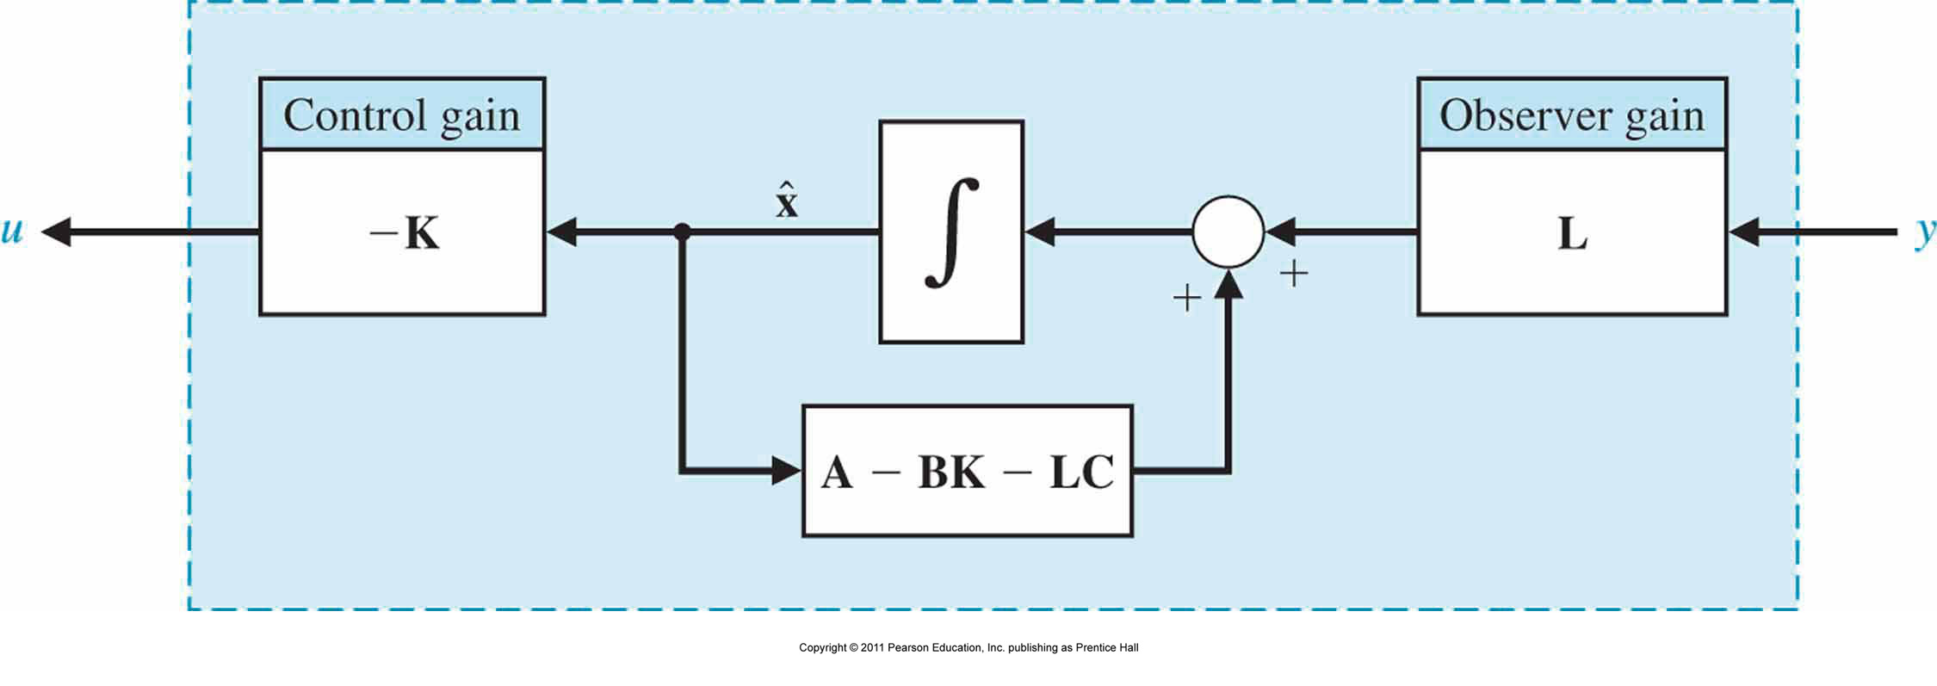
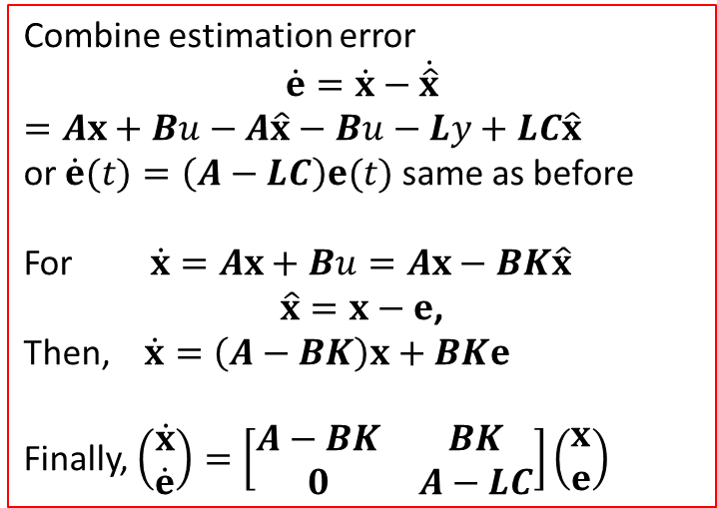
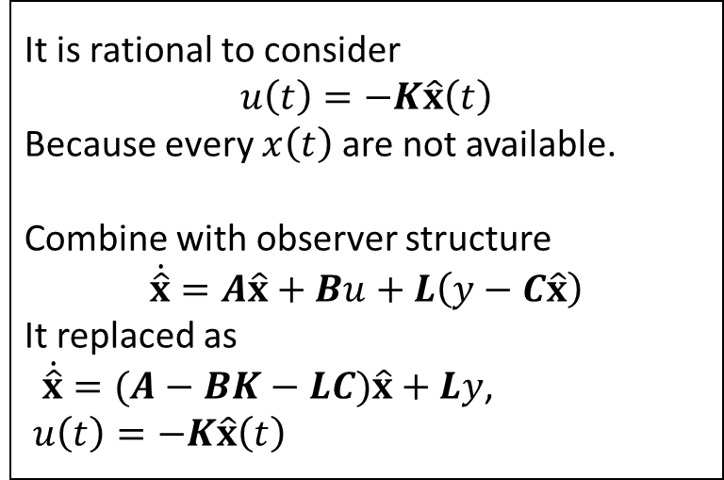
Integration of Estimator and Observer
It is rational to consider
$$u\left(t\right)=−K\hat{x}\left(t\right)$$
Because every $x\left(t\right)$ are not available.
Combine with observer structure
$$\dot{\hat{x}}=A\hat{x}+Bu+L\left(y−C\hat{x}\right)$$
It replaced as
$\dot{\hat{x}}=(A−BK−LC)\hat{x}+Ly$,
$u\left(t\right)=−K\hat{x}\left(t\right)$
Combine estimation error
$$\dot{e}=\dot{x}−\dot{\hat{x}}$$
$=Ax+Bu−A\hat{x}−Bu−Ly+LC\hat{x}$
or $\dot{e}(t)=\left(A−LC\right)e(t)$ same as before
For $\dot{x}=Ax+Bu=Ax−BK\hat{x}$
$\hat{x}=x−e$,
Then, $\dot{x}=\left(A−BK\right)x+BKe$
Finally, $\left(\begin{matrix}\dot{x} \\ \dot{e}\end{matrix}\right)=\left[\begin{matrix}A−BK & BK \\ 0 & A−LC\end{matrix}\right]\left(\begin{matrix}x \\ e\end{matrix}\right)$

Slide 20
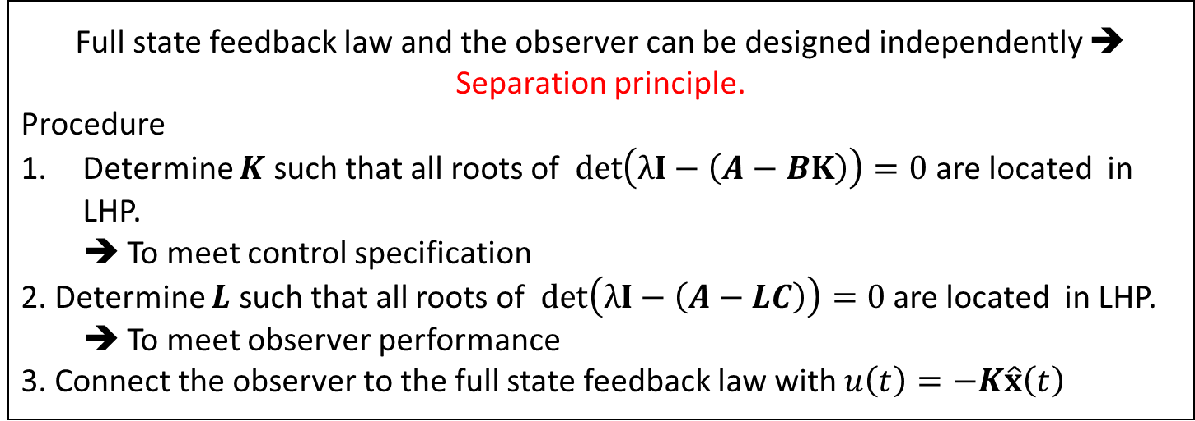
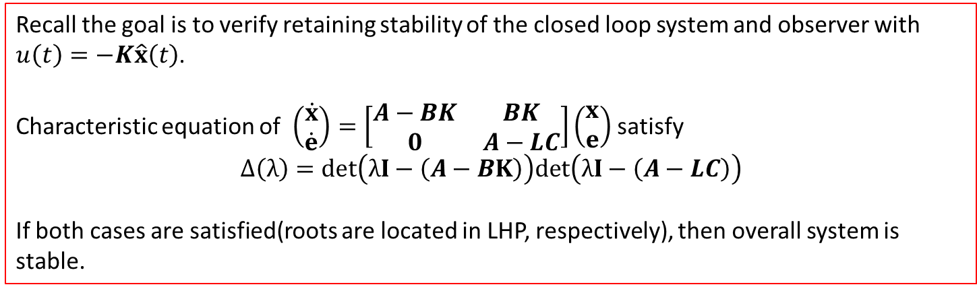
Integration of Estimator and Observer : Summary
Recall the goal is to verify retaining stability of the closed loop system and observer with $u\left(t\right)=−K\hat{x}\left(t\right)$.
Characteristic equation of $\left(\begin{matrix}\dot{x} \\ \dot{e}\end{matrix}\right)=\left[\begin{matrix}A−BK & BK \\ 0 & A−LC\end{matrix}\right]\left(\begin{matrix}x \\ e\end{matrix}\right)$ satisfy
$$Δ\left(λ\right)=det\left(λI−\left(A−BK\right)\right)det\left(λI−\left(A−LC\right)\right)$$
If both cases are satisfied(roots are located in LHP, respectively), then overall system is stable.
Full state feedback law and the observer can be designed independently ➔ Separation principle.
Procedure
Determine $K$ such that all roots of $det\left(λI−\left(A−BK\right)\right)=0$ are located in LHP.
➔ To meet control specification
2. Determine $L$ such that all roots of $det\left(λI−\left(A−LC\right)\right)=0$ are located in LHP.
➔ To meet observer performance
3. Connect the observer to the full state feedback law with $u\left(t\right)=−K\hat{x}\left(t\right)$

Slide 21
End of Lecture
State Space and Integrated System - Lecture 4
Instructor: Sanghyuk Lee
Sanghyuk.Lee@xjtlu.edu.cn
Tel: 8816-1415
Department of Electrical and Electronic Engineering
XJTLU

